Slide 1
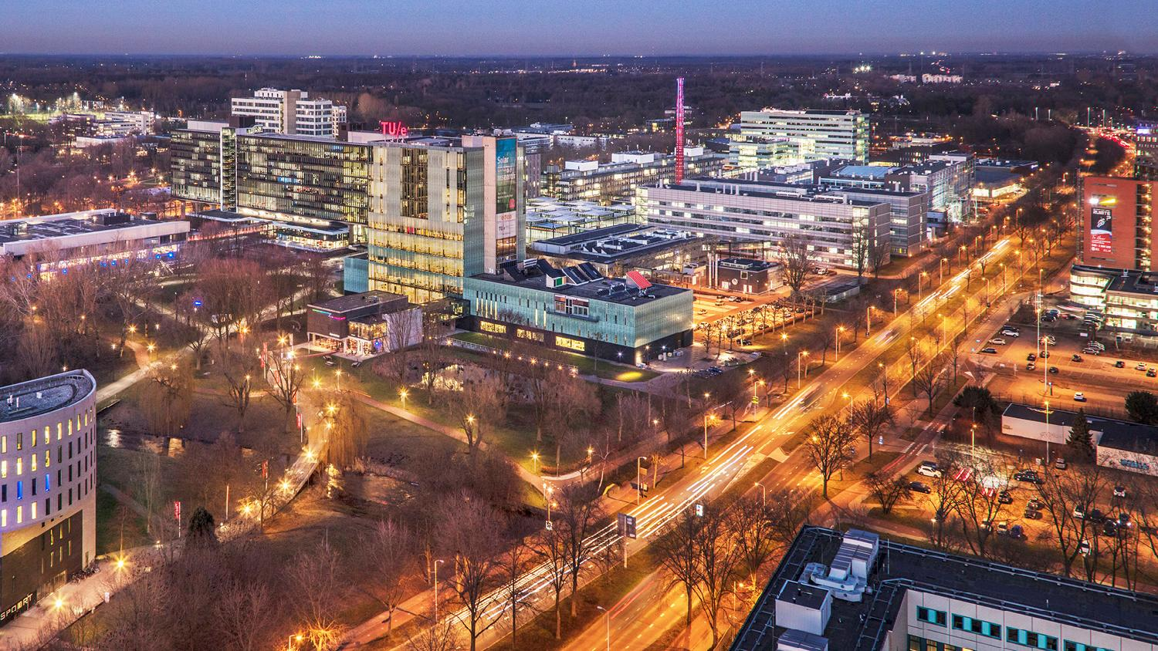
Evaluation of Quantization Methods for
Neural Networks
JUNAID MUNDICHIPPARAKKAL
Master Thesis Presentation
22nd December 2022
Committee:
dr. ir. Wil Michiels
dr. ir. Sibylle Hess
ir. Frits Schalij
Department of Mathematics and Computer Science
Notes:
Hi, I am junaid. I am presenting my thesis titled "Evaluation of quantization methods for NNs deployment";
thank you for being in my presentation and allowing me to present my thesis online.

Slide 2
Overview
Context
Thesis Objectives
Background
Experiment Plan
Experiment Results
Conclusion and Future Work
Notes:
Let me give a quick overview about this presentation.
First we will discuss the context of this thesis and explain the thesis objective.
And then some background information about this thesis.
This thesis experiment driven hence experiment pplan and results are discussed.
The conclusion with some recommendations and Future work is explained.

Slide 3


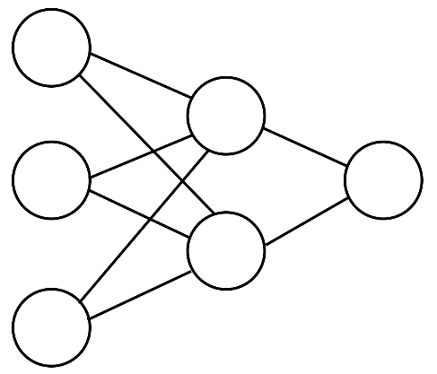



Machine Learning
Autonomous vehicles
Home automation
Neural networks
Machine Learning
Applications
Healthcare
Security
Smartphones
Notes:
Machine learning is becoming an indispensable part of everyday life.
It has applications in different fields like Healthcare, autonomous vehicles, home automation, smartphones and security.
NNs are a specific type of machine-learning approach which is used in these applications.

Slide 4
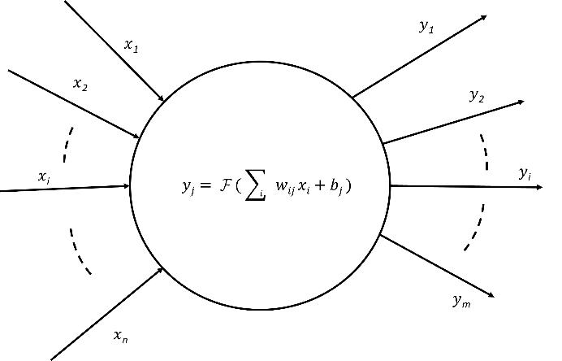
What are Neural Networks?
NNs are computing systems made up of several layers of interconnected nodes.
Activation function
Biases
Input layer
Hidden layer
Output layer
Weights
Notes:
NNs are computing systems made up of several layers of interconnected nodes.
Where a NN consist of input layer, hidden layers and output layer.
And each node in a NN can be defined as this, ---- these nodes consists of weights, biases and activation function

Slide 5


NN Models Deployment
Reduction of model size is key for successful edge deployment of NN models
Solutions
Reduce the size of the NN architectures.
(Example:EfficientNet, SqueezeNet and DenseNet )
NN model deployment
Edge
Cloud
            2. Reduce the size of already existing models
        Knowledge distillation
        Pruning
        Quantization
✔ Resource scalable
✘ Resource constrained
Focus of this work is on quantization in isolation
Notes:
Let us assume we have a NN for any given applicationIt can be deployed in two ways: in cloud and edge devices
Cloud systems are scalable in terms of computation. In comparison, edge devices are resource constrained.
NNs can be very big. In such cases reducing the size of the NNs are key to successful deployment in edge devices.
The size reduction can be reduced by
(1)Building SOTA architectures that are small in size, Example: efficient det, squeeze net and densenet or
(2) reducing the size of existing NN’s
There are three methods, knowledge distillation, pruning and quantization– and these three methods can be in combination,
in this work, we use quantization in isolation

Slide 6



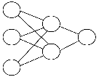
Thesis Context
SOTA Quantization Methods
Tested on pretrained NN models
Not many architectures and datasets experimented.
Many concepts yet to be implemented in the frameworks.
Need options to save / deploy quantized models.
SQuant
TensorFlow Lite
TensorFlow Micro
QKeras
Aimet
Literature
Frameworks
Design
Manufacture
Apply quantization for NN deployment
Selection of the quantization methods for deployment
Customers
NN models
Notes:
This thesis is done at NXP Semiconductors, a company which designs and manufactures semiconductors for various applications.
NXP now have customers who require to deploy NN in their chips.For efficient deployment of NN, quantization is needed.
Several SOTA methods exist in the literature, and many frameworks for quantization.
Some of the concerns are listed here.The methods are tested on pre-trained models or not tested on many architectures and datasets. Or these concepts are yet to be implemented in a framework or don't support saving or development.

Slide 7
Thesis Objectives
Evaluate a set of state-of-the-art NN quantization techniques by experimenting them on a set of different state-of-the-art (SOTA) NN model architectures.
Investigate the applicability of the considered quantization techniques for production use cases ( image classification and object detection) in order to achieve size reduction while retaining the performance of the models.
Notes:
Before we dive deep into how these objectives are reached Let us have a brief explanation of some background information about quantization.

Slide 8
Quantization
Each set of values quantized have a unique set of quantization parameters
Table 1
Table 2
Table 3
If Table1=Table3: Ideal case of quantization
If Table1≠Table3: Due to error introduced during quantization.
32-bit float precision
0.254
0.278
0.494
0.426
0.631
0.165
0.512
0.505
0.306
8-bit INT precision
49
62
180
143
255
0
190
186
77
32-bit float precision
0.255
0.278
0.494
0.427
0.631
0.165
0.514
0.506
0.306
Quantization
Dequantization
Quantization error
Mapping the values of a large set into a smaller one
Mapping the values from the quantized values into the original large values
Clipping function
Rounding operation
Notes:
Quantization is the mathematical function which maps values from a large set into a smaller set.
For example, here table 1: values of precision of 32 bits float are quantized to values of 8-bit integer precision.
All the values of table 1 are quantized with
Each set of values have a unique set of quantization parameters:
Using these quantization parameters the original values of table 2 can be retrieved. This is termed dequantization and is shown in table 3.
If Table1=Table3: Ideal case of quantization
If Table1≠Table3: Due to error introduced during quantization.
This error is called quantization error and is mainly due to clipping function and rounding operation in quantization

Slide 9
Clipping Function
Set of values to be quantized
Example : 4-bit quantization
Table 1
Table 2
Table 4
The set of values to be quantized are clipped into a range
10
111
112
113
114
115
116
117
230
10
98
98
112
112
112
112
112
230
111
111
111
113
113
115
115
117
117
Quantized and then dequantized
Range[min, max]
Min-Max clipping
Based on the minimum and maximum values of the set of values to be quantized
Table 3
111
111
112
113
114
115
116
117
117
Quantized and then dequantized
Clipped to range [111,117]
MSE based range setting
Based on minimization

Slide 10
Rounding Operation
Value to be rounded
Round-to-nearest
3.14
Round-to-nearest
    The value is rounded to the nearest integer value.
SQuant-hessian
3
SQuant-hessian
The value may be rounded to the smallest or the largest nearest integer value.
3
4
or
Notes:
In this work two types of rounding operations are used round to nearest and SQuant hessian
Rounding operations round the values. Let us take example 3,14, a value to be rounded.
Using round to nearest, the values are rounded to the nearest integer value .
i.e 3
While using Squant hessian, the value is rounded to the nearest smallest or largest integer value i.e., either to 3 or 4
Which is solved by using a minimization problem

Slide 11
Quantization in Neural Network
Effect of quantization
Weights: 32bits
Biases : 32 bits
Accuracy
8-bit quantization
Inference time
Weights: 8bits
Biases : 8 bits
Model size
Weights, biases and outputs of activations are quantized separately for each layer.
Notes:
Quantization is NN is done by reducing the precision of weights biases and output of activation layers to smaller precisions.
For example, in this work: 32-bit precision model quantization to 8 bits, means the model parameters and outputs of activation layers are quantized to 8 –bits.
There are several ways quantization can be applied.
In this work, each layer is quantized separately and with in each layer weights, biases and outputs of activations are also quantized separately.
Each set of values quantized its own quantization parameters.
Quantization in NN effect the accuracy, inference time and model size.
The accuracy may be dropped due to the quantization errors.
The inference time has a penalty due to the dequantization during inference.
and the size of the model is reduced

Slide 12
Types of Quantization (Based on How Quantization is Applied)
Quantization Types
Quantization aware training (QAT)
Post training quantization (PTQ)
Data free quantization (DFQ)
✘ Model retrained ✔ Model not retrained ✔ Model not retrained
✘ Requires labeled data ✘ Requires unlabeled data ✔ Requires no data
✘ Model parameters updated ✔ Model parameters not updated ✘ Model parameters updated
✔ Quantization parameters updated
Notes:
Quantization can be of three types based on how quantization is applied to NN.
QAT, PTQ and DFQ
All the methods have the case of quantization parameters updated
the model parameters are updated for QAT and DFQ no in case of PTQ.
The model is only retrained in the case of QAT, and this requires labelled data,
PTQ uses unlabelled data for quantization,
and DFQ uses no data at all for quantization

Slide 13
Quantization Support in Frameworks
Frameworks | Types of layers | Supported quantization methods
TensorFlow Lite | Keras | PTQ and QAT
QKeras | QKeras | QAT
SQuant | PyTorch | DFQ
Quantization capabilities of these frameworks
 |  | Types of quantization |  | Precisions supported |  |  | Clipping range |  |  | Type of clipping |  | Rounding operation
 | parameters | Uniform | Non-uniform | 16 | 8 | <8 | Min-Max clipping | MSE based range setting | BN method | Symmetric | Asymmetric | Round to nearest | SQuant hessian
TensorFlow Lite | Weights and biases | ✔ |  | ✔ | ✔ |  | ✔ |  |  | ✔ |  | ✔
 | Activations |  |  |  |  |  |  |  |  |  | ✔
SQuant | Weights | ✔ |  | ✔ | ✔ | ✔ |  | ✔ |  | ✔ |  |  | ✔
 | Activations | ✔ |  | ✔ | ✔ | ✔ |  |  | ✔ | ✔ |  | ✔
QKeras | Weights and biases | ✔ | ✔ | ✔ | ✔ | ✔ | ✔ |  |  | ✔ |  | ✔
 | Activations |  |  |  |  |  |  |  |  |  | ✔
Notes:
The frameworks TensorFlow Lite, Qkeras and SQuant are investigated in this work
Tensorflow Lite uses model with Keras layers and supports both PTQ and QAT
Qkeras uses models with Qkeras layers and supports only QATS
Quant uses Pytorch layers and only supports DFQ
The table shows the quantization capabilities of each framework.
The SQuant framework does not support the quantization of biases.
Tensorflow Lite only supports 16 and 8-bit quantization, while Qkeras and Squant support 16,8 and < 8-bit quantization.

Slide 14
Experimental Plan Summary
Architectures
NN usecases | Model Architectures | Model Information |  |  | Evaluation Metric
 |  | Number of layers | Number of parameter (Millions) | Training image size
lmage classification | MobileNet | 90 | 20.6 | 128 x 128 x 3 | Accuracy
 | ResNet50 | 179 | 57.8 | 128 x 128 x 3
 | InceptionV3 | 315 | 30.8 | 128 x 128 x 3
Object detection | EfficientDet-LiteO | 237 | 3.2 | 224 x 224 x 3 | Mean Average Precision (mAP)
 | SSD_MobileNet | * | * | 320 x 320 x 3
 | CenterNet | * | * | 512 x 512 x 3
 | RetinaNet | * | * | 512 x 512 x 3
* Denotes that theses values was not able to be calculated due to the format these models where saved
Datasets
NN usecases | Dataset | Number of classes | Number of training images | Number of testing images
lmage classification | Oxford iiit pet (Oxford) | 37 | 3673 | 3662
 | Cifar10 | 10 | 50000 | 10000
Object detection | Pascal-VOC | 20 | 15672 | 16720
Notes:
This work only investigates the use-casesof NN,
image classification and object detection.
A summary of architectures and datasets used is shown here.
Architectures Mobilenet, resnet50 and inceptionv3 are trained for datasets cifar10 and oxford iiit pet dataset,
the metric of evaluation used is Accuracy.
Architectures efficient det lite 0, ssd_mobilenet, centernet and retinanet models are trained for pascal-voc dataset,
the evaluation metric used in Mean Average precision.

Slide 15
Image Classification: Objectives
    16-bit quantization using TensorFlow Lite
    8-bit quantization using TensorFlow Lite
    32,16 and 8-bit quantization using QKeras.
    8,6 and 4-bit quantization using SQuant.
Notes:
The image classification experiments have 4 objectives

Slide 16
Objective 1: 16-bit quantization using TensorFlow Lite
QAT
PTQ
Observed that even though the quantization precision for the NN layers is set as 16-bits, the obtained quantized model uses the precision 8-bits.
It is interesting to notice that the model compression percentage is not 50%, this is due to the fact the 32-bit precision models are saved in the format h5 which may contain other values that model parameters and model architectures.
To the best of our knowledge, the option of 16-bit QAT is not available in TensorFlow Lite.
All the layers quantized except the input and output layer
Model size compression: ∼75%
Change in accuracy : <1%
Notes:
Objective -1: 16-bit quantization using tensorflow lite
For QAT method:
Even though we provide 16-bit quantization to tensorflow lite, the resultant models are at 8 bit precision,
so we conclude that to the best of our knowledge Qat at 16-bit is not available in Tensorflow Lite
While for 16 bit quantization using PTQ if we quantize all the layers except the input and output layer
We get a model compression around 75% and change in accuracy of <1%

Slide 17
Objective 2: 8-bit quantization using TensorFlow Lite
QAT
PTQ
All the layers quantized except the input layer
Model size compression: ∼85%
Change in accuracy : <1%
All the layers quantized except the input and output layer
Model size compression: ∼85%
Change in accuracy : <1%
Notes:
Objective 2: 8-bit quantization using QAT, When we quantize all layers with 8 bit precision we get change in accuracy very high while simply keeping the input layers not quantized prodices a change in accuracy of <1%.
All the models give a model compression around 85%
Simillar experimetns are conducted for PTQ in tensorflow lite to resulting the change accuracy <1% only in case of quantizing all the layers expect the input layer

Slide 18
Objective 3: 32,16 and 8-bit quantization using QKeras.
QAT
ResNet50
Change in accuracy : >95%
Might be due to the conversion of the model from TensorFlow to QKeras.
Notes:
Objective 3 : 32,26 and8 – bit quantization shows >95% change in accuracy leading with two different mapping functions for resnet50
As other models couldn't be converted due to errors.
And the large in error accuracy might be due to conversion of TensorFlow model to Qkeras models

Slide 19
Objective 4: 8,6 and 4-bit quantization using SQuant.
DFQ
Input layer precision: 8 bits
Input layer precision: 32 bits
All the layers quantized except the input layer
Quantization bit precision | Change in accuracy(%)
8 | <1
6 | <5
4 | <25
19
19
Title of the presentation - by tab Insert -> Header text and Footer text
Evaluation of Quantization methods for Neural Networks
Notes:
Objective 5 :8,6,4 bit quantization using Squant
This graph shows a change in accuracy of <1% for 8 –bit quantization expect for resnet50 at input precision of 8 bits.
While all the model shows change in accuracy of <1%, <5% and <25% for 8,6 and 4 –bit while quantizing all the layers expect the input layer.

Slide 20
Object Detection-Objective
    16 and 8-bit quantization using TensorFlow Lite.
Only one framework is experimented due to time constraints
Notes:
For object detection there is only one objective,
16 and 8 bit quantization using TensorFlow Lite.

Slide 21
Objective 5: 16 and 8-bit quantization using TensorFlow Lite
16 and 8-bit quantization check for Efficientdet-Lite0,
SSD _MobileNet, CenterNet and RetinaNet .
8-bit quantization using PTQ for SSD_MobileNet with suspected layer method.
Only SSD_MobileNet was successfully quantized using TensorFlow Lite
Suspected layers are a set of layers of the NN; quantizing them will lead to a severe drop in accuracy.
16 and 8-bit quantization using PTQ for SSD_MobileNet.
Serial Number | Unquantized |  | Change in mAP(%)
 | First N layers | Suspected Layers
1 | 0 | 0 | 90.44
2 | 1 | 0 | 3.15
3 | 5 | 0 | 1.31
4 | 0 | 1 | 86.87
5 | 1 | 1 | 1.24
6 | 5 | 1 | 1.33
Quantization bit precision | 16 | 8
Change in mAP (%) | <2 | >95
Model compression (%) | ∼75 | ∼85
Remarks | Quantize all layers expect input and output layers | The change in mAP not acceptable
Change in mAP : <2%
21
Evaluation of Quantization methods for Neural Networks
Notes:
Efficientdet-Lite0, SSD _MobileNet, CenterNet and RetinaNet where quantized by TensorFlow lite. Only SSd_mobile was sucessfuly quantized.
For 16-bit quantization the model

Slide 22
Conclusion
Implemented Quantization techniques using frameworks TensorFlow Lite, SQuant and Qkeras on image classification and object detection use cases.
Investigated the percentage change in accuracy and model compression on different combinations of model architectures and datasets.
Some recommendations are made for quantization of NN models used in this work

Slide 23
Recommendation for Quantization - 1
Design
QAT
PTQ
Manufacture
Yes
Labelled
Apply quantization for NN deployment
No
DFQ
Yes
Representative Data
No
Customers
NN models

Slide 24
Recommendation for Quantization - 2
NN use cases
Image classification
Object detection
Framework
TensorFlow Lite
SQuant
TensorFlow Lite
Quantization method
PTQ
QAT
DFQ
PTQ
Quantization bit precision
16
8
8
8
6
4
16
8
Input layer
✔
✔
✔
✔
✔
✔
✔
✔
Quantize all layers
Output layer
✔
✔
✔
✔
except
Suspected layers
✔
Model compression (%)
∼75
∼85
∼85
*
*
*
∼75
∼85
Change in accuracy (or mAP) (%)
<1
<1
<1
<1
<5
<25
<2
<2

Slide 25
Future Work
  Experiment with the QKeras framework by building SOTA architectures using QKeras layers.
  Try to fix the error of quantization in TensorFlow Lite for object detection models other than SSD_MobileNet or find other model architectures that TensorFlow Lite supports.
  Suspected layers calculated with RMSE and Scale factor did not have an appreciable impact. Exploring other methods might provide a better solution.
  Investigate quantization using SQuant framework for object detection.

Slide 26
Thank you
Department of Mathematics and Computer Science

Slide 27
Slides for defense questions

Slide 28
Quantization simulation
Quantizer function
Quantization
Unique set of quantization parameters
Dequantization

Slide 29


Suspected Layers
32-bit float precision
0.254
0.278
0.494
0.426
0.631
0.165
0.512
0.505
0.306
32-bit float precision
0.255
0.278
0.494
0.427
0.631
0.165
0.514
0.506
0.306
Quantized and then dequantized
Step 1:
Quantize and dequantize the NN each layer of the NN.
Calculate RMSE and quantization parameters.
Step 2:
The threshold is calculated for each layer in the NN.
Step 3:
For each layers in the NN :
              If Threshold of a layer > 0.7 :
              Do not quantize the layer
              Else :
              Quantize the layer
$$Threshold=\frac{RMSE}{Scale factor}$$
User defined
$$RMSE$$

Slide 30
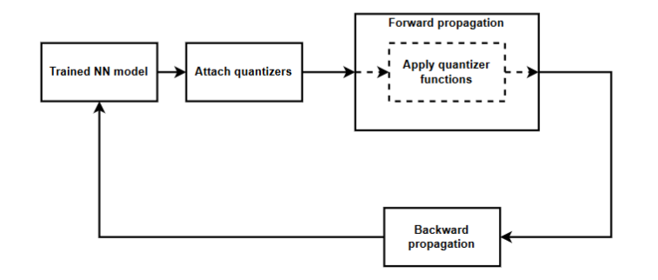
QAT

Slide 31
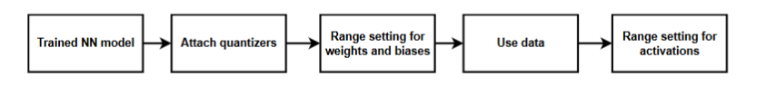
PTQ

Slide 32
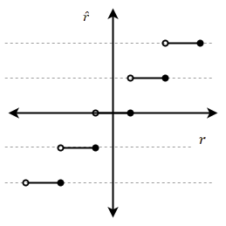
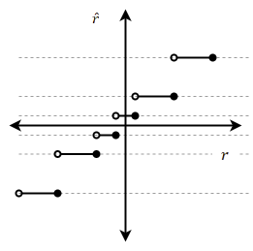
Types of Quantization
Uniform
Non-uniform

Slide 33
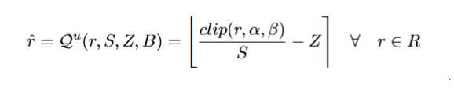

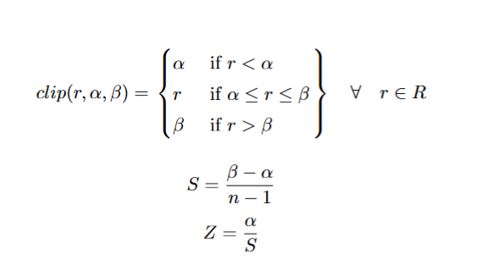
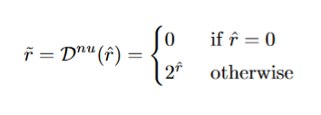

Examples quantization functions
Clipping function (clip)
Uniform quantization function: Quantized_bits
Non-uniform quantization function: Quantized_po2
Quantization function :Uniform:- Quantized_bits
Rounding operator (⌊⌉)
Dequantization function
33
33
Evaluation of Quantization methods for Neural Network
Evaluation of Quantization methods for Neural Network

Slide 34
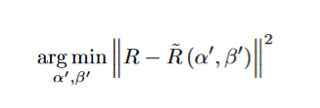
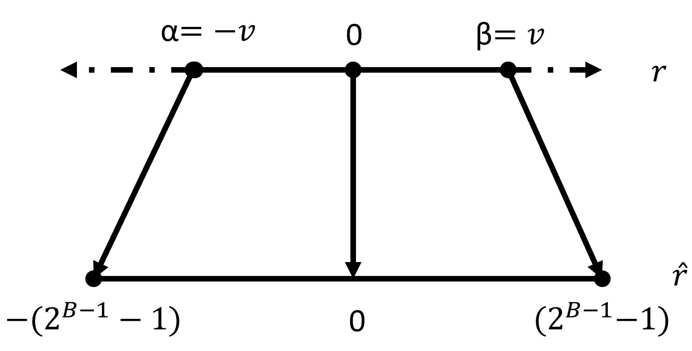
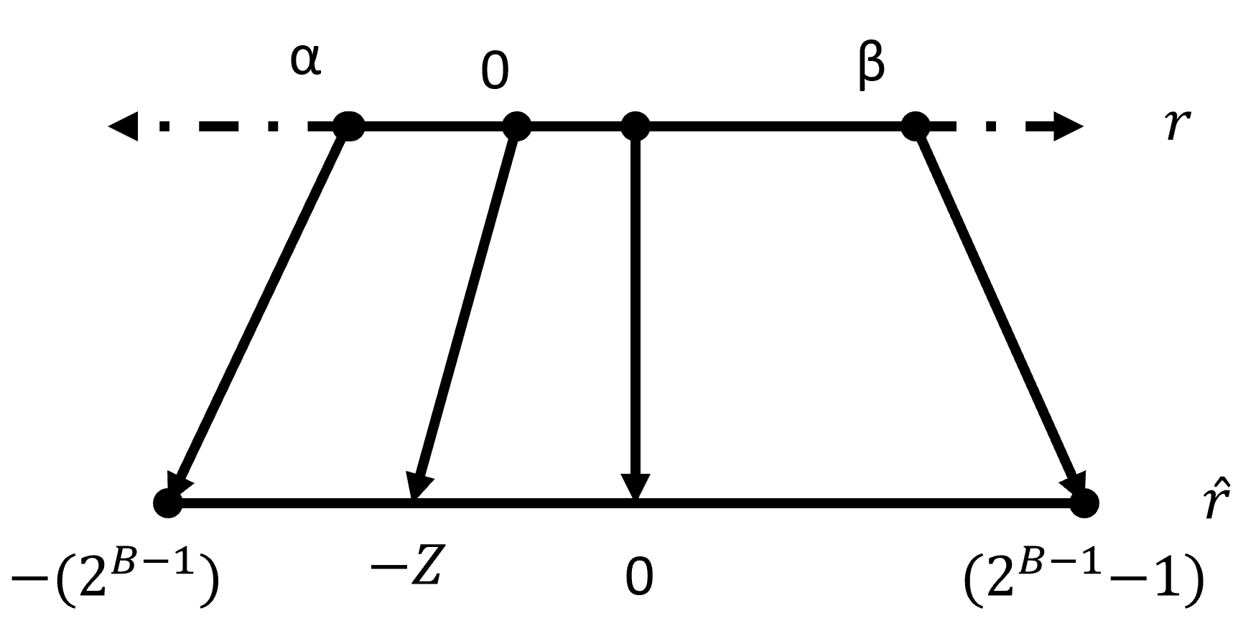
Clipping operations
Min-Max clipping
Based on the minimum and maximum values of the set of values to be quantized
[ ] Clipping range
Can be calculated using
MSE based range setting
Based on the minimization
Symmetric
Asymmetric
34
Evaluation of Quantization methods for Neural Network

Slide 35
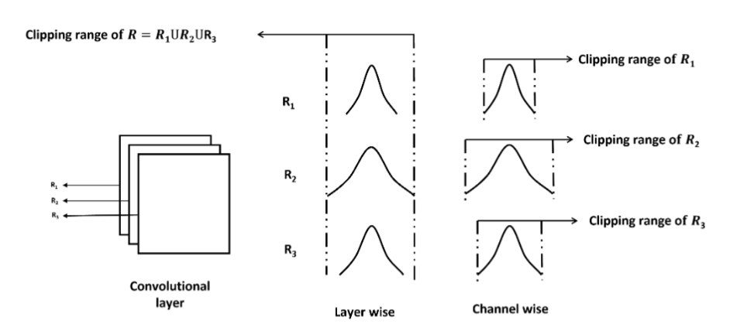
Quantization granularity

Slide 36
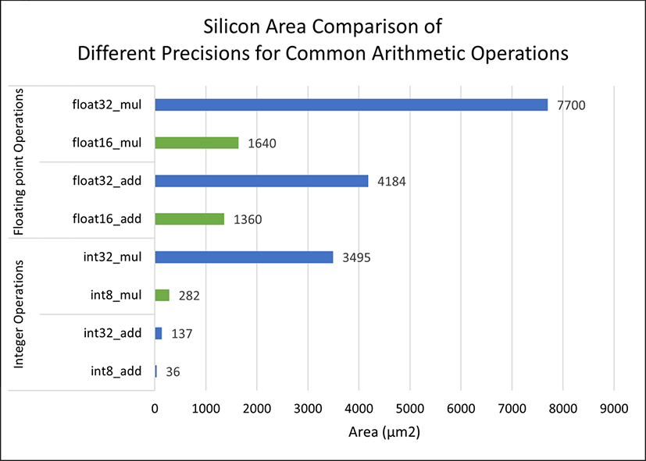
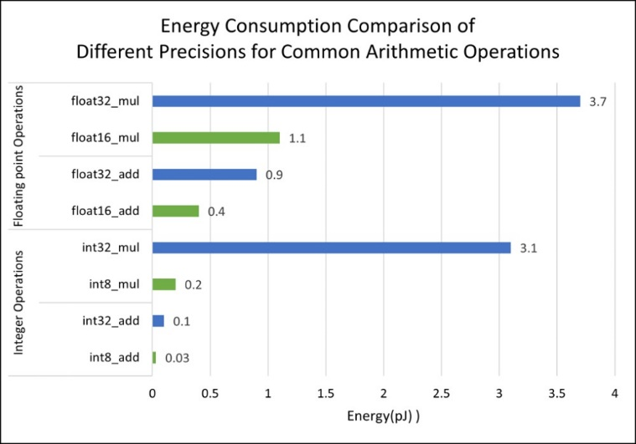
Effect of quantization on NN

Slide 37
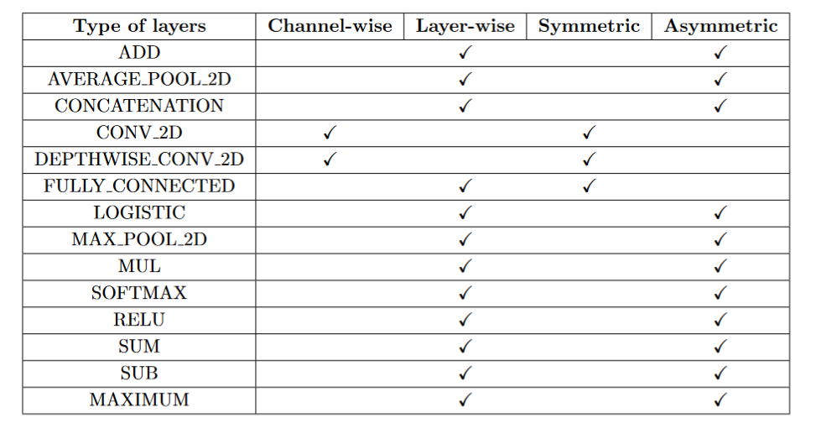
Quantization of different NN layers

Slide 38
SQuant

Slide 39
NN models deployment
NN models
Cloud
Edge
Data source
Edge
Results
Data source
via internet
Cloud
Results
 | Cloud | Edge
Latency | High | Low
Internet | Needed | Not needed
Data source | Far compared to the edge | At the edge
Computing power | High | Limited
Applications | Less time sensitive application | Fast decision-making and Real-time uses cases

Slide 40
Types of Quantization (Based on How Quantization is Applied)
Quantization Types
Quantization aware training (QAT)
Post training quantization (PTQ)
Data free quantization (DFQ)
✔ Quantization parameter updated
✘ Model parameters updated
✘ Model retrained
✘ Requires labeled data
✔ Quantization parameter updated
✔ Model parameters not updated
✔ Model not retrained
✘ Requires unlabeled data
✔ Quantization parameter updated
✘ Model parameters updated
✔ Model not retrained
✔ Requires no data
Notes:
Quantization can be of three types based on how quantization is applied to NN.
QAT, PTQ and DFQ
All the methods have the case of quantization parameters updated
the model parameters are updated for QAT and DFQ no in case of PTQ.
The model is only retrained in the case of QAT, and this requires labelled data,
PTQ uses unlabelled data for quantization,
and DFQ uses no data at all for quantization

Slide 41
Recommendation for Quantization - 2
NN use cases |  | Image classification |  |  |  |  |  | Object detection
Framework |  | TensorFlow Lite |  |  | SQuant |  |  | TensorFlow Lite
Quantization method |  | PTQ |  | QAT | DFQ |  |  | PTQ
Quantization bit precision |  | 16 | 8 | 8 | 8 | 6 | 4 | 16 | 8
Quantize all layers except | Input layer | ✔ | ✔ | ✔ | ✔ | ✔ | ✔ | ✔ | ✔
 | Output layer | ✔ | ✔ |  |  |  |  | ✔ | ✔
 | Suspected layers |  |  |  |  |  |  |  | ✔
Model compression (%) |  | ∼75 | ∼85 | ∼85 | * | * | * | ∼75 | ∼85
Change in accuracy (or mAP) (%) |  | <1 | <1 | <1 | <1 | <5 | <25 | <2 | <2

Slide 42
Quantization Support in Frameworks
Frameworks | Types of layers | Supported quantization methods
TensorFlow Lite | Keras | PTQ and QAT
QKeras | QKeras | QAT
SQuant | PyTorch | DFQ
Quantization capabilities of these frameworks
Types of
Precisions
Rounding
Clipping range
Type of clipping
quantization
supported
operation
Non
-
Min
-
parameters
Uniform
16
8
<8
Max
MSE based
BN method
Symmetric
Asymmetric
Round to
SQuant
uniform
clipping
range setting
nearest
hessian
Weights and
✔
TensorFlow
biases
✔
✔
✔
✔
✔
Lite
Activations
✔
Weights
✔
✔
SQuant
✔
✔
✔
✔
✔
Activations
✔
✔
Weights and
✔
QKeras
biases
✔
✔
✔
✔
✔
✔
✔
Activations
✔
Notes:
The frameworks TensorFlow Lite, Qkeras and SQuant are investigated in this work
Tensorflow Lite uses model with Keras layers and supports both PTQ and QAT
Qkeras uses models with Qkeras layers and supports only QATS
Quant uses Pytorch layers and only supports DFQ
The table shows the quantization capabilities of each framework.
The SQuant framework does not support the quantization of biases.
Tensorflow Lite only supports 16 and 8-bit quantization, while Qkeras and Squant support 16,8 and < 8-bit quantization.

